Slide 1
The Anatomy and Physiology of the Respiratory System

Slide 2
Functions of the Respiratory System
  Air Distributor
  Gas exchanger
  Filters and warms air
  Influences speech
  Allows for sense of smell

Slide 3
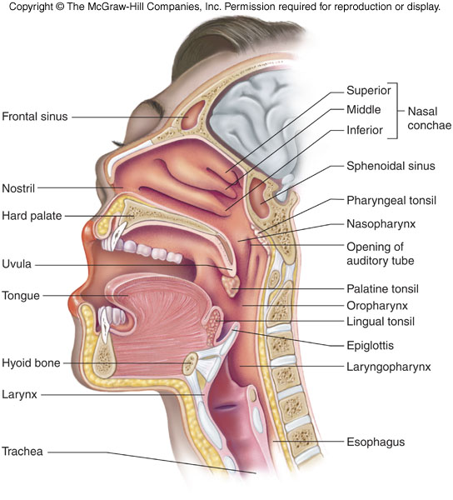
Divisions of the Respiratory System
Upper respiratory tract (outside thorax)
  Nose
  Nasal Cavity
  Sinuses
  Pharynx

Slide 4
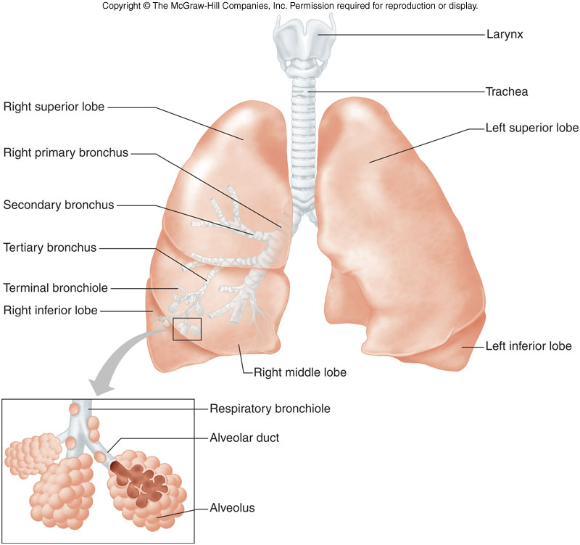
Divisions of the Respiratory System
Lower respiratory tract (within thorax)
  Larynx
  Epioglottis
  Trachea
  Bronchial Tree
  Lungs

Slide 5
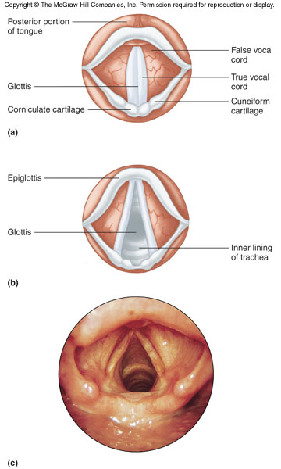
Structures of the Lower Respiratory Tract
Epiglottis - flap of skin (hatch) on trachea, moves when swallowing and speaking. Closes off trachea when swallowing food
Trachea (windpipe) Consists of smooth cartilage and C shaped rings of cartilage.
Larynx - voice box
Made of cartilage
2 pairs of folds

Slide 6
Structures of the Lower Respiratory Tract
Bronchi
  Tubes that branch off trachea and enter into lungs
  Ciliated ( have hairs)
  Primary bronchi
  secondary bronchi
  tertiary bronchi
  Bronchioles
  Terminate into alveolar sacs
  Gas exchange with blood occurs in sacs.

Slide 7
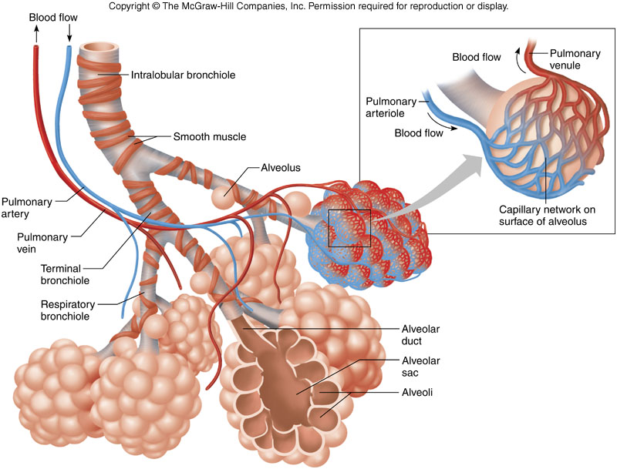

Slide 8
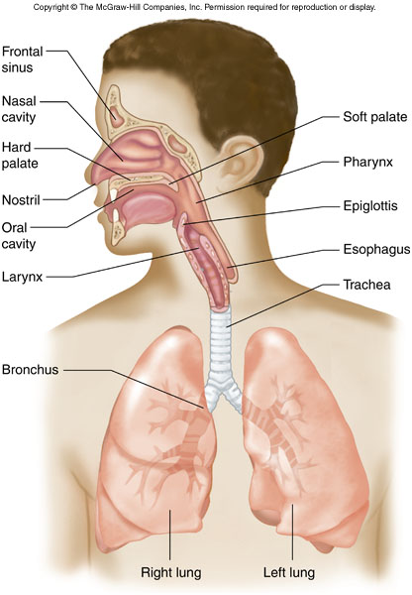
Structures of the Lower Respiratory Tract
Lungs
Right has 3 lobes and left has 2 lobes

Slide 9
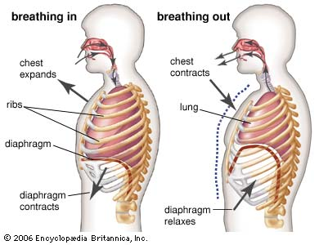
http://people.eku.edu/ritchisong/301notes6.htm

Slide 10
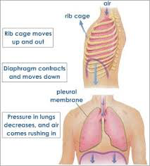
Inspiration: Breathing In
  Diaphragm contracts (moves down) and intercostal muscles pull the ribs wider

Slide 11
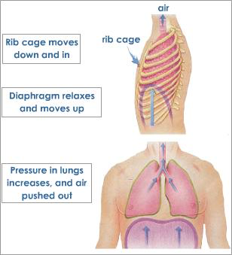
Expiration: Breathing Out
Relaxation of diaphragm (moves up) and the intercostal muscles bring the rib cage back in

Slide 12
Volumes of Air Exchange
Tidal volume - amount of air exhaled normally after a typical inspiration. Normal - about 500 ml
Residual volume - amount of air that stays trapped in the alveoli (about 1.2 liters).

Slide 13
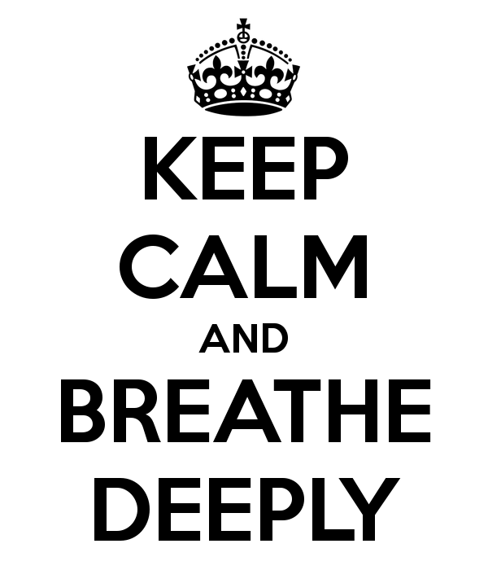
Volumes of Air Exchange
Vital capacity - the largest volume of air an individual can move in and out of the lungs.

Slide 14
Review Questions
1. Which of the following is not a function of the respiratory system?
A. Influence speech
B. Distribution of oxygen to cells
C. Filtration of air
D. Warming of air
2. The common name for the trachea is _______

Slide 15
3. The structure that stops food from moving into the trachea when swallowing is the ______________
4.The smallest branches of the bronchial tree are the
Primary bronchi
Secondary bronchi
Tertiary bronchi
Bronchioles

Slide 16
5. During inspiration which of the following does not occur?
Diaphragm contracts
Rib muscles relax
Diaphragm flattens
Size of thorax increases

